Slide 1
Pythonic
Lambda
Recursive

Slide 2
# Use f-string to print variable
a = [1, 2, 3]
print(f'id(a)={id(a)}')
b = a
print(f'id(b)={id(b)}')
b.append(4)
print(f'{a=} {b=}')
--------------------
id(a)=4376737920
id(b)=4376737920
a=[1, 2, 3, 4] b=[1, 2, 3, 4]
# Fun tricks with zip
foo = [[1, 2, 3], [4, 5, 6]]
boo = list(zip(*foo))
print(f'{boo=}')
-----------------------
boo=[(1, 4), (2, 5), (3, 6)]
# to rotate a list
mylist = [1, 2, 3, 4]
# rotate left - start element goes to the end
mylist_1 = mylist[1:] + [mylist[0]] #[2, 3, 4, 1]
# rotate right end element goes to the start
mylist_2 = [mylist[-1]] + mylist[:-1] #[4, 1, 2, 3]
#rotating 3 variables
a = 'l'; b = 'm'; c = 'r'
print(f'{a=} {b=} {c=}')
a, b, c = c, a, b
print(f'{a=} {b=} {c=}')
#Choosing a random letter with uppercase
import random
import string
random_letter = random.choice(string.ascii_uppercase)
print(f'{string.ascii_uppercase =}')
#Identify if any characters are numbers
my_string = '1234'
foo = any(map(str.isnumeric, my_string))
boo = all(map(str.isnumeric, my_string))
# Dividing a list into groups of n
l = [3, 1, 4, 1, 5, 9, 2, 6, 5, 3, 5, 8]
result = zip(*[iter(l)] * 3)
for item in result:
print(item)
-----------------------
(3, 1, 4)
(1, 5, 9)
(2, 6, 5)
(3, 5, 8)
# List comprehensions and generator expressions
a = [1, 2, 3]
b = []
for x in a:
b.append(10 * x)
print(f'{b=}')
c = [10 * x for x in a]
print(f'{c=}')

Slide 3
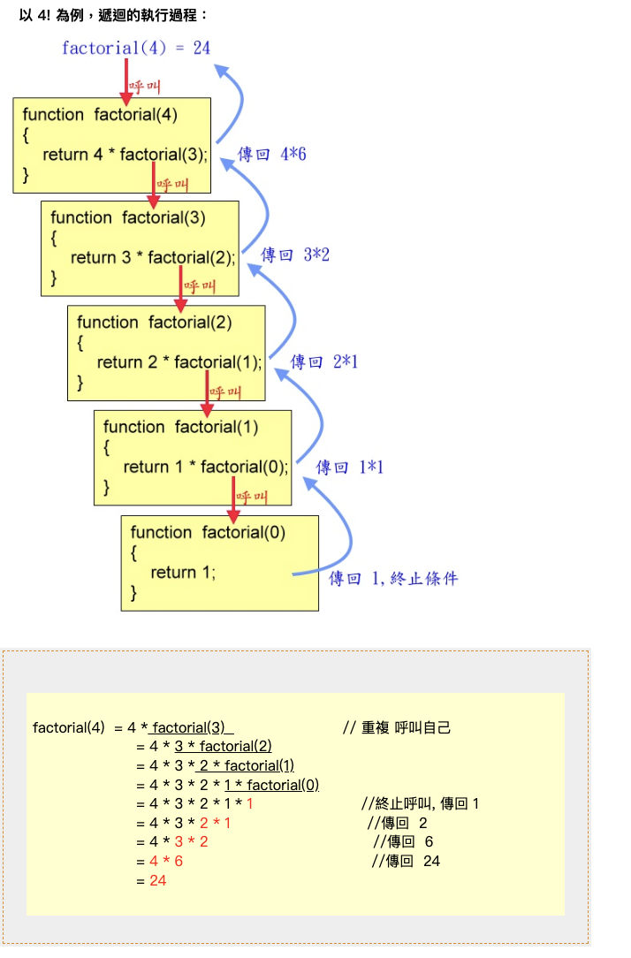
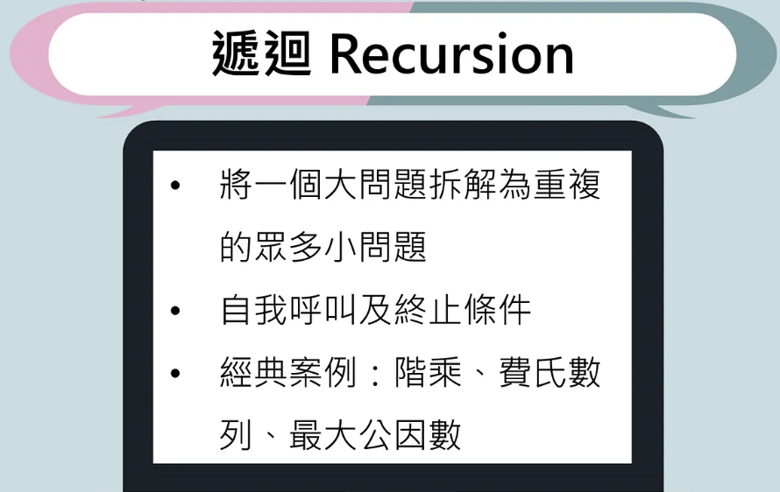
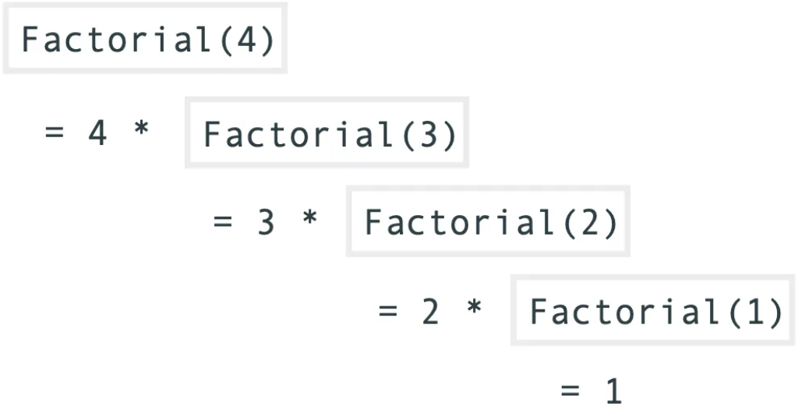
遞迴函數
https://medium.com/ccclub/ccclub-python-for-beginners-tutorial-11ed5d300d3d

Slide 4
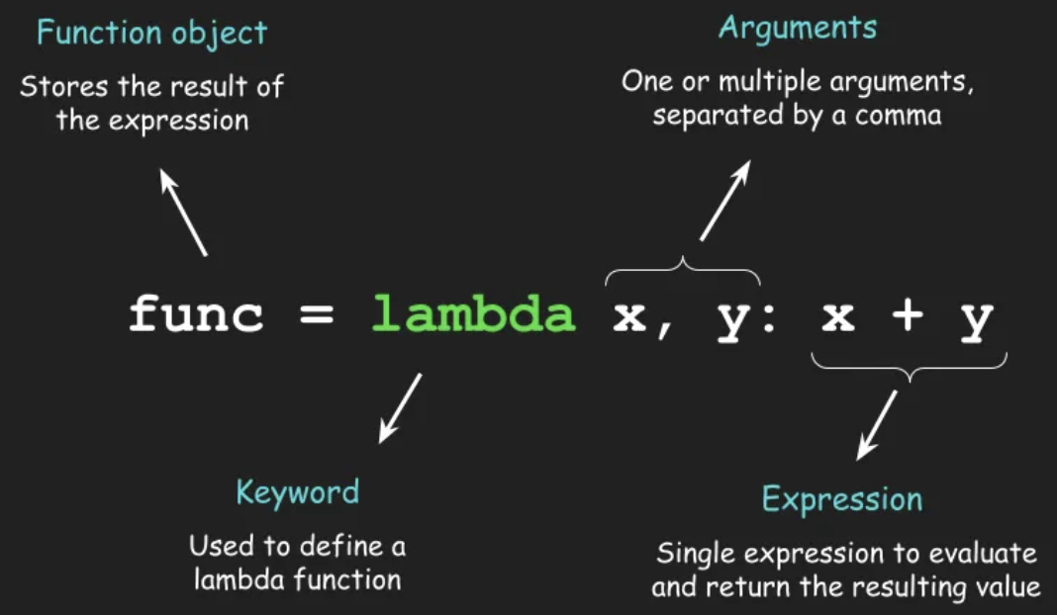
Lambda Function
def fun(x):
return 2 * x
fun = lambda x: 2*x

Slide 5
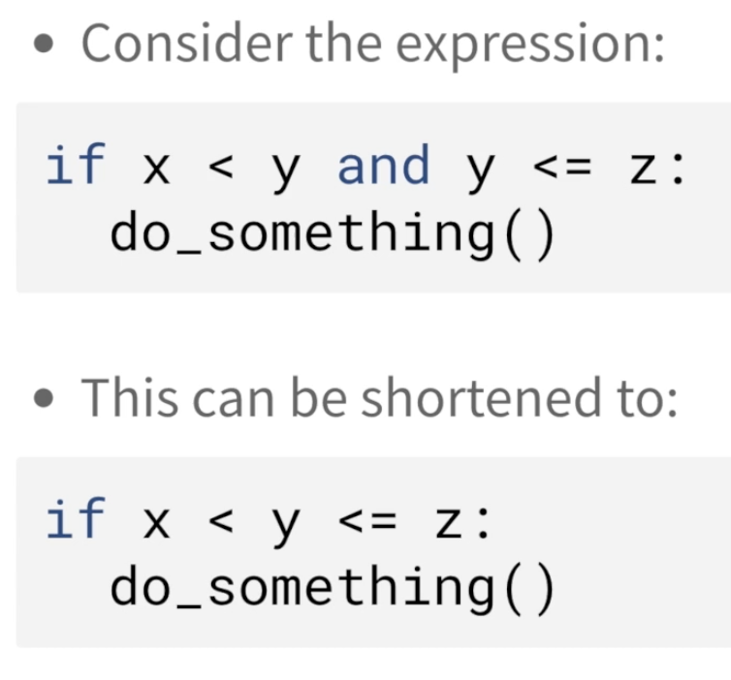
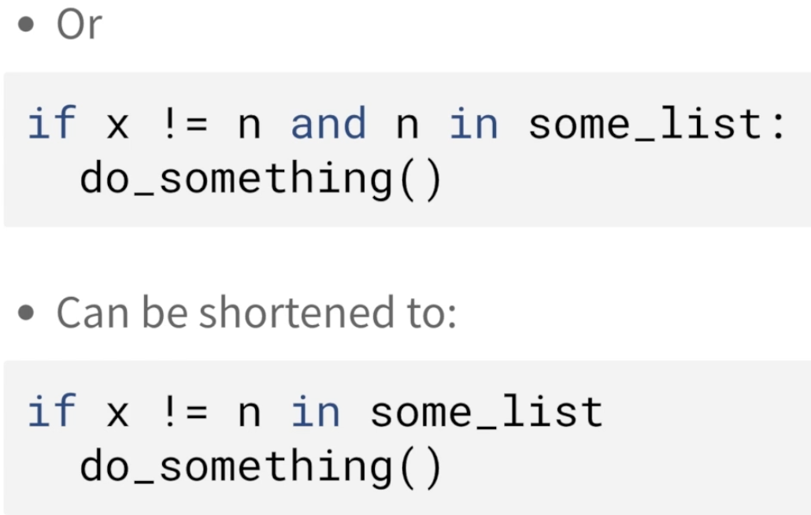
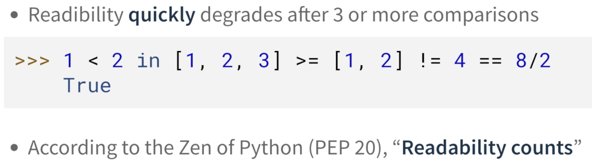
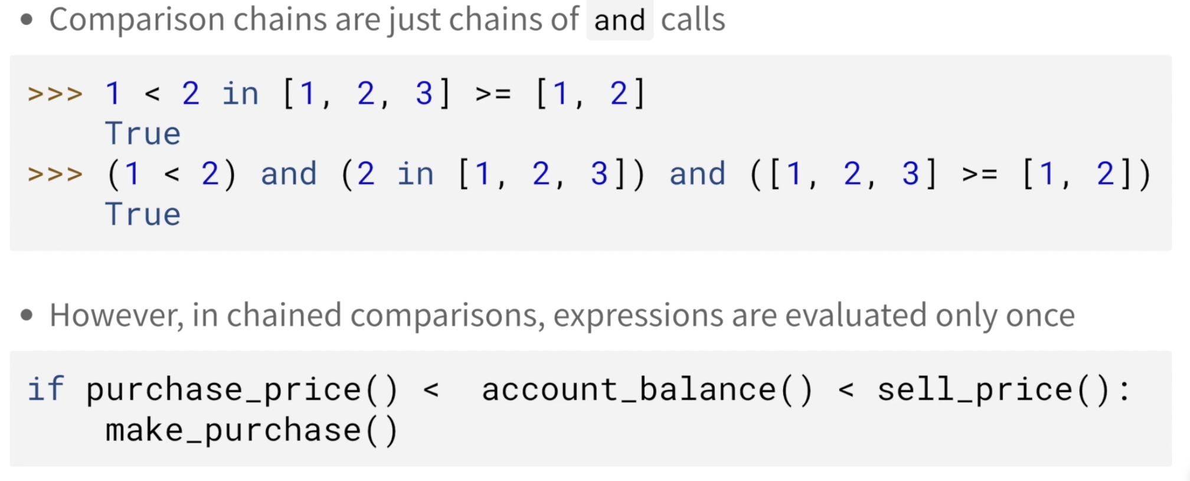
Chain Comparison Operators

Slide 6
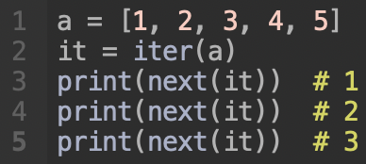
迭代器
在使用列表的時候，有時候需要對列表進行遍歷，但是又不希望把整個列表都加載到內存中。這時候，可以使用列表的迭代器：
這個例子中，我們使用 iter 函式將列表轉換成迭代器，然後使用 next 函式來取出下一個元素。這樣的方式可以節省內存空間，特別是當列表很大的時候。

Slide 7
Comprehensive List
squares = (x**2 for x in range(1, 11)) for square in squares: print(square)
# alt-1
x=10
a = []
for i in range(x):
if i % 2 == 0:
a.append(i)
#alt-2
b = [i for i in range(x) if i%2 == 0]
pairs = [(x, y) for x in range(1, 3) for y in ['a', 'b']] print(pairs) # output: [(1, 'a'), (1, 'b'), (2, 'a'), (2, 'b')]
numbers = [1, 2, 3, 4, 5, 5, 4, 3, 2, 1] unique_numbers = {x for x in numbers} print(unique_numbers) # output: {1, 2, 3, 4, 5}
squares = (x**2 for x in range(1, 11)) print(next(squares)) # 1 print(next(squares)) # 4 print(next(squares)) # 9
ascii_dict = {chr(x): x for x in range(97, 123)} print(ascii_dict) # output: {'a': 97, 'b': 98, 'c': 99, ..., 'x': 120, 'y': 121, 'z': 122}

Slide 8
Walrus Operator - 檢查串列的長度是否大於10
方法一
n = len(my_list)
if n > 10:
print(f"We have {n} items in our list.")
方法二: 用海象運算子
if (n := len(my_list)) > 10:
print(f"We have {n} items in our list.")

Slide 9
Metasyntactic Variables (元語法變數)
General: foo, bar, baz. qux, foobar, quxx, corge, grault, garply, waldo, fred, plugh, xyzyx, thud
Python: spam, ham, eggs

Slide 10
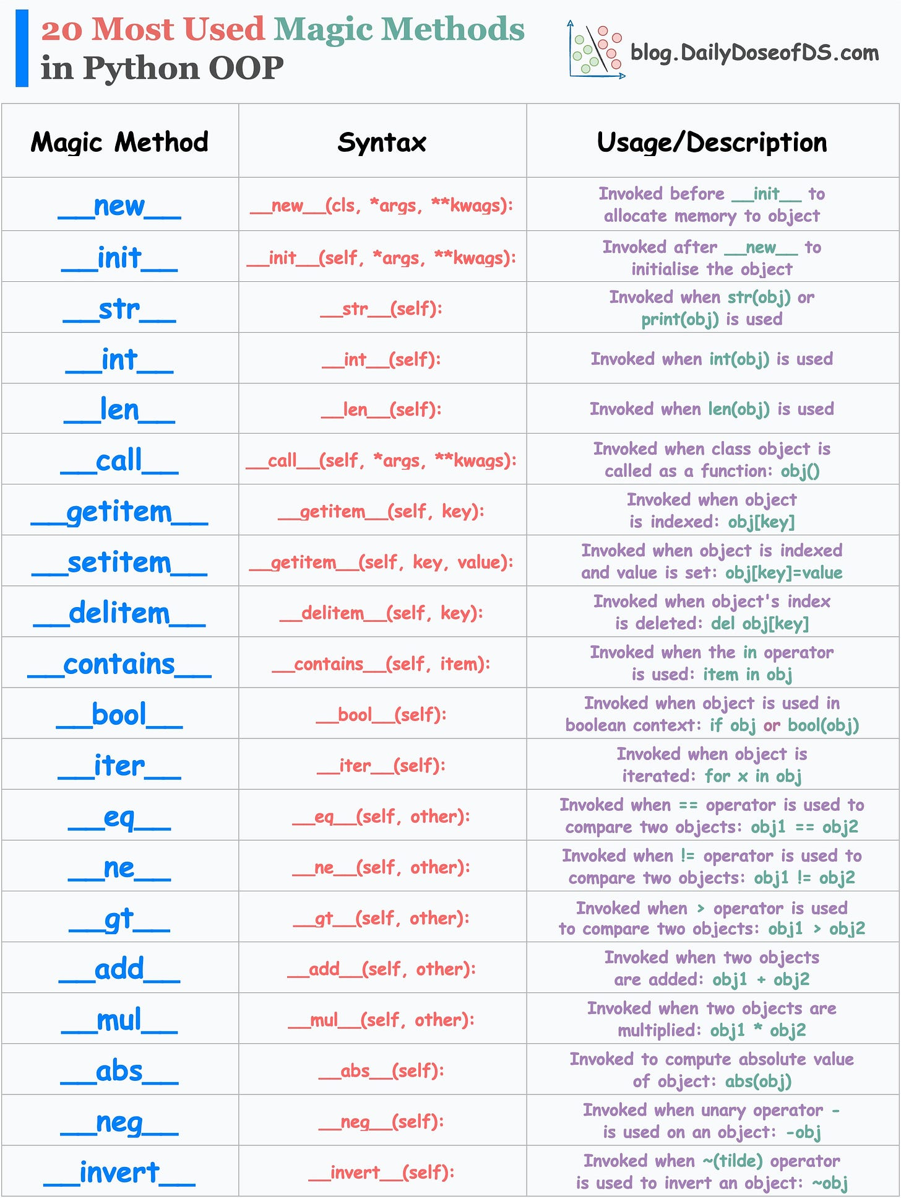
Python OOP Magic Methods

Slide 11
Boolean Operation
a =3
v = ('No','Yes')[a>5]

Slide 12
Enumerate Function
enumerate() 函數用於將一個可遍歷對象（如列表、元組、字典等）轉換為帶有索引的枚舉對象，通常用於 for 迴圈中。它的語法如下：
enumerate(iterable, start=0)
# 枚舉列表中的元素
fruits = ['apple', 'banana', 'cherry']
for i, fruit in enumerate(fruits):
print(i, fruit)
# 枚舉字典中的鍵值對
person = {'name': 'John', 'age': 30, 'city': 'New York'}
for i, (key, value) in enumerate(person.items()):
print(i, key, value)

Slide 13
Zip Function
zip() 函數用於將多個可遍歷對象組合成一個元組序列，通常用於 for 迴圈中。它的語法如下：
zip(*iterables)
其中 iterables 表示要組合的可遍歷對象，* 表示解包。例如：
# 將兩個列表組合成一個元組序列
fruits = ['apple', 'banana', 'cherry']
colors = ['red', 'yellow', 'green']
for fruit, color in zip(fruits, colors):
print(fruit, color)
# 將多個列表組合成一個元組序列
numbers = [1, 2, 3]
letters = ['a', 'b', 'c']
names = ['John', 'Mary', 'Tom']
for num, letter, name in zip(numbers, letters, names):
print(num, letter, name)

Slide 14
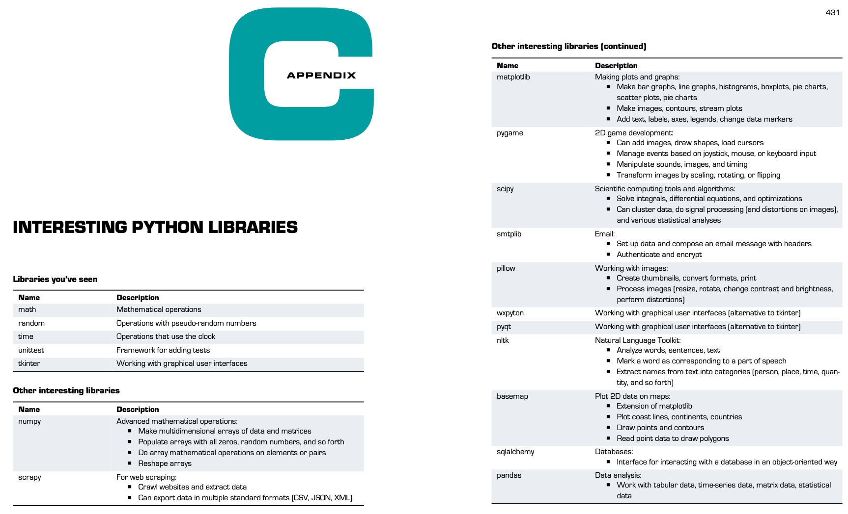
Interesting Python Library

Slide 15
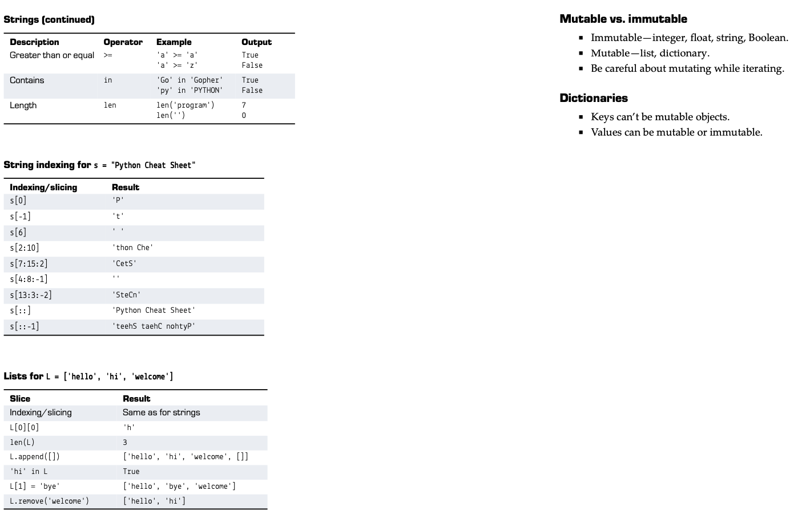
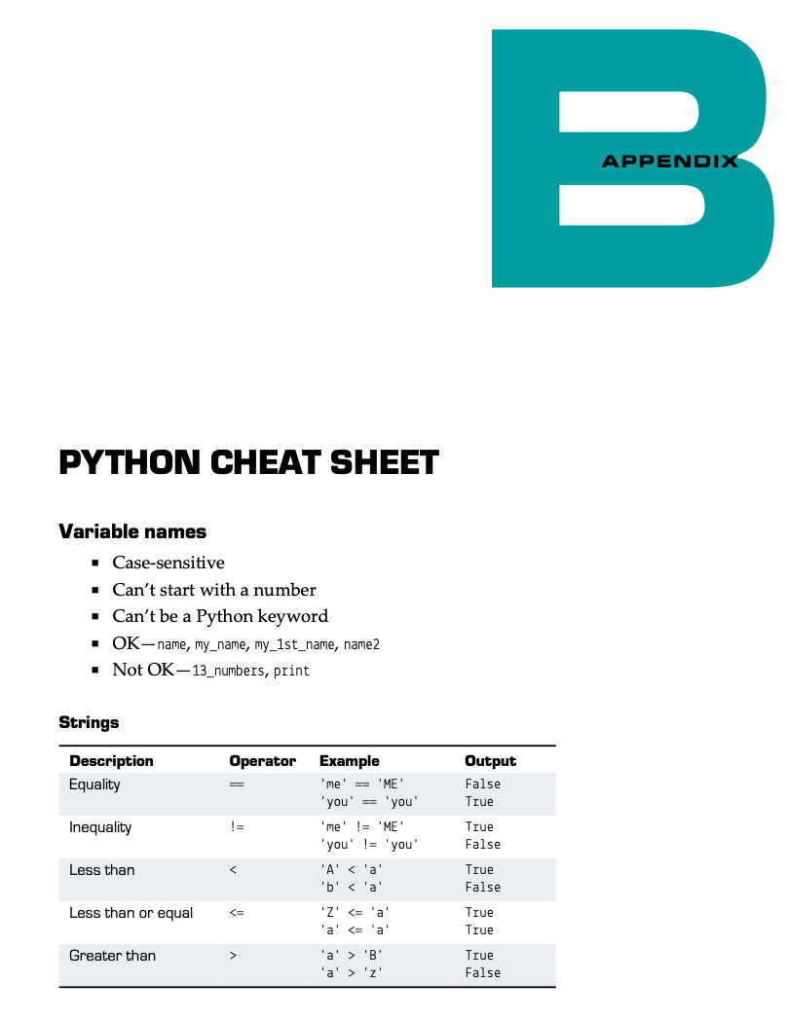
Python Cheatsheet

Slide 16
#Homework XXXXX

Slide 17
#整合專案 XXXX

